Slide 1



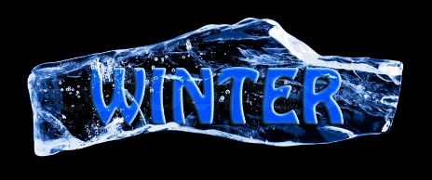
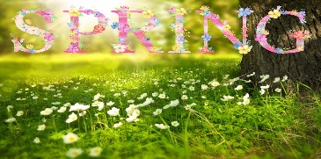
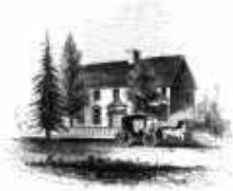
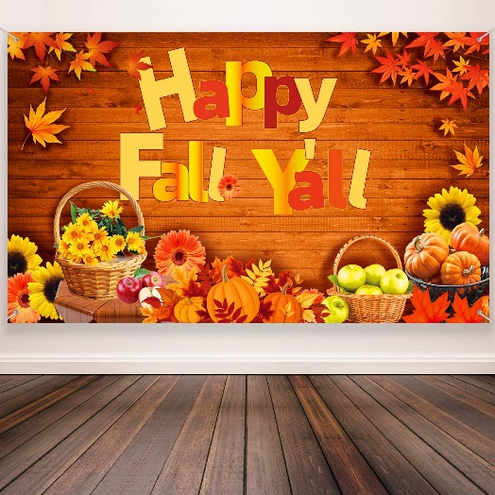


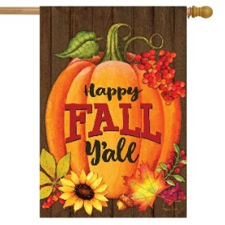
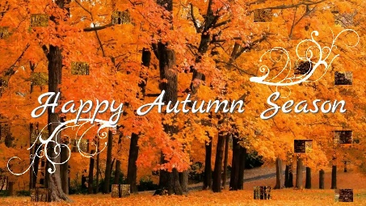
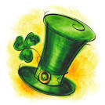


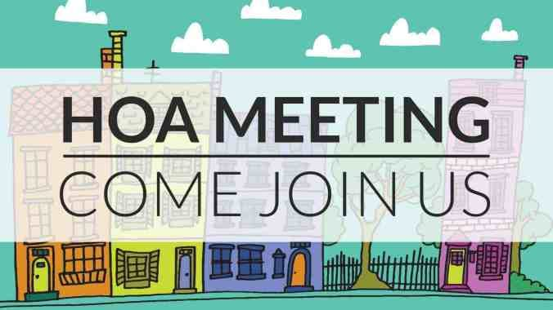


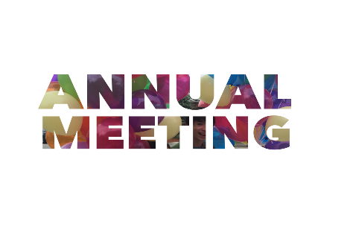

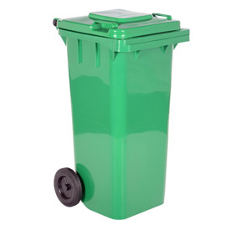

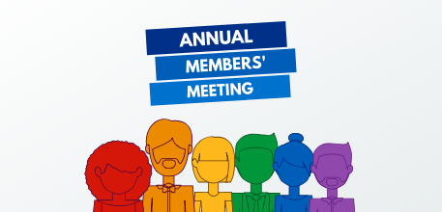





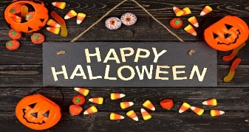

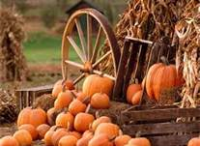

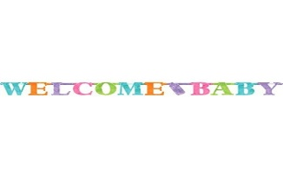



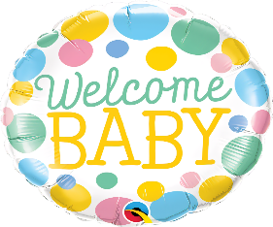













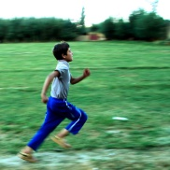
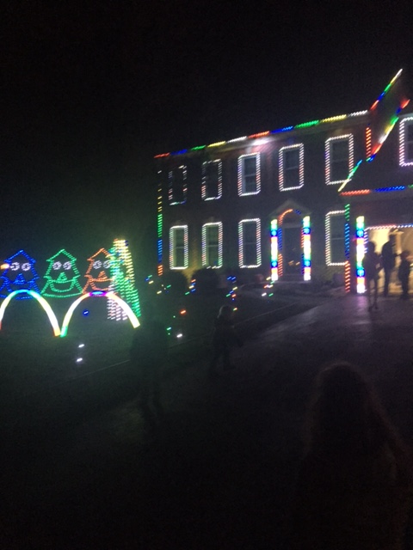
The Docket
November 2022 Page 1 of 9
The Homeowners’ Association newsletter for
THE GABLES AT LAWYERS’ HILL
ELKRIDGE, MARYLAND
President- Brenda Schweiger
Vice President- Mike Wolek
Treasurer- Bev Johnson
Secretary- Angela Shiplet
Member at Large (1) John Fritz
Member at Large (2) Ashley Gerrity
Member at Large (3) Zach Zentz
Webmaster- Brenda Schweiger
GALH Annual meeting 2019
The Gables Annual HOA Members Meeting was held as announced at The Stained Glass Pub in Elkridge with a successful turnout of 18 homes represented. Please view the minutes from our Annual Meeting, posted on our website under the “ Gables HOA” tab to read about our meeting.
The 2019 final financial report and 2020 budget can also be found on our website under the “Gables HOA” tab GALH Financial.
Many thanks to all who attended the social and meeting!!!
Inside this Issue
Annual Members Meeting 1 Annual Hospitality Table 1 Welcome New Babies 1 We’re looking for Board members 1 welcome to the Team 1 Gables Food Truck Nights 1 Architectural News 2 GALH Annual Property Inspections 3 2022 Preliminary Budget 4 2022 Annual Assessments 5 GALH Board Duties 6 and 7 Louisiana Hot Crab Dip 8 GALH Board, Committees and Emails 9
F
Letter From the Board 2020
Many thanks to the neighbors who participated
In the Spring Egg Hunt this year. Our neighbors were
very creative with their designs
2014 Annual Members Meeting
N
Let’s give a big shout out to community member, Susan Lavin
(Continued on page 2)
The Gables at Lawyers Hill Association will be holding its Annual Members Meeting on December 7, 2021, at 7:00 pm. At Stained Glass Pub in the basement meeting room. Starting a 6:30pm we will host a social with appetizers and beverages. The Annual Meeting will start at 7:00 pm
Please plan to attend
This year is an important year to get
out and vote, it’s our civic duty.
Please check the below links to register
to vote by mail or yo can avoid crowds
And vote early.
visit https://elections.maryland.gov/voting/absentee.html
https://www.bing.com/search?q=howard+county+vote
+by+mail&form=ANSPH1&refig=d7accaf994bc4f3cbc48
262008dac0c5&pc=U531&sp=-1&ghc=1&pq=howard+
county+vote+by+mail&sc=1-26&qs=n&sk=&
cvid=d7accaf994bc4f3cbc48262008dac0c5
if you wish to vote in person on November 3rd, our voting place is at Elkridge Landing Middle school
Say Hello to our Welcoming Committee
During our Annual Meeting the Board asked for volunteers to
be part of our welcoming committee to welcome new neighbors
and give them information regarding our community.
The members are:
Elizabeth Culbertson
Susan Lavin
Chris Matney
Angela Shiplet
Laurie Tarsia
New Neighbors:
Jennie and Bymy Park on
Summer Home Terrace
This year’s Hospitably Halloween tables will be
held at 6230 Latchlift Ct., October 31, from 6:00
To 9:00. There will be refreshments and treats for all.
GALH Board
Welcome New Babies
Our community would like to
Congratulate two families with new additions to their family.
Congratulations:
Balajem family Baby boy
Gerrity family- Baby boy
New Board Members Needed for 2022
The Board is recruiting for new Board members to
join our Board next year for 2022. Please see page 5 for Board member responsibilities and email the Board at gablesboard@thegablesinfo.com if you are interested. Continued page 5
Feed the Green Recycle cans available from HC
Just go to link and fill out form
https://data.howardcountymd.gov/gfoodscrapprogram/
Architectural Committee
Annual Spring Egg Hunt
GABLES FOOD TRUCK NIGHTS!
Enjoy an easy & delicious dinner with pick up at
a designated area in our community.
Great for catching up or meeting
new neighbors!
Taco Bar Food Truck:
Nov. 17 4pm-7pm (Wed)
https://www.facebook.com/TacoBarFoodTruck/
2 BOLD Chefs & a Mediterranean Food Truck:
Jan. 13, Feb. 10 & Mar. 24
4:30pm-7:30pm (Thursdays)
https://www.facebook.com/2-BOLD-Chefs-a-Mediterranean-Truck-Catering-1065628833553310/
Many Thanks to Chris Matney for putting this together
Annual Spring Egg Hunt
Welcome New Committee Members
The Board would like to welcome two new members to our Website and Editing Committee
Welcome new members
Liz Culbertson- Chief Editor
Erik Gregg- Technical Configurations
Important Email & Facebook Addresses
HOA Board- gablesboard@thegablesinfo.com
ArchComm- archcomm@thegablesinfo.com
|
Facebook Group- The Gables at Lawyers Hill
Annual Members Zoom Meeting- December 7, 2021 at Stained glass Pub
Next Quarterly Board Meeting- January 10, 2022 Next Architectural Meeting- March 15, 2022
Did you see the beautiful light show this year in our community?
Graftons View Holiday Light show
Hope everyone had a chance to stop by and see the beautiful light show set up by our neighbor, Jay Cook on Graftons view. We like to thank Jay for hosting a community get together to learn about how he did it.
See page 4 to see how Jay set this up
If anyone would like to host our Annual Spring Egg Hunt, please Email the Board at:
gablesboard@thegablesinfo.com
School 5K Run
Waiting on info from Angela

Slide 2


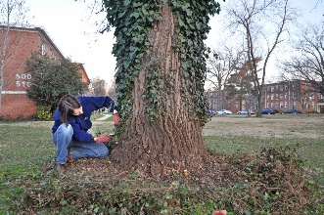
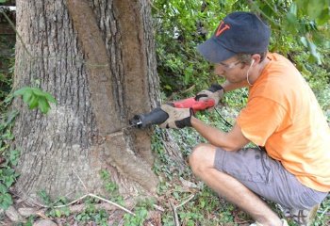
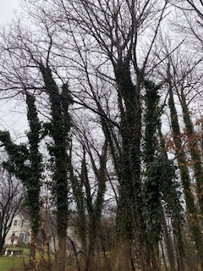
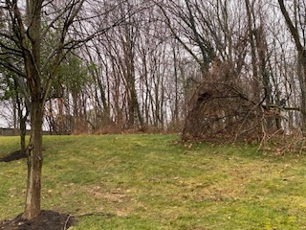
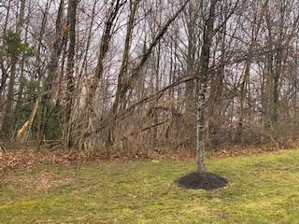
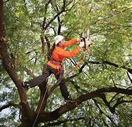
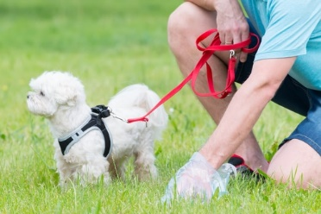
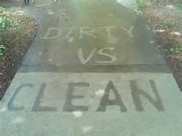
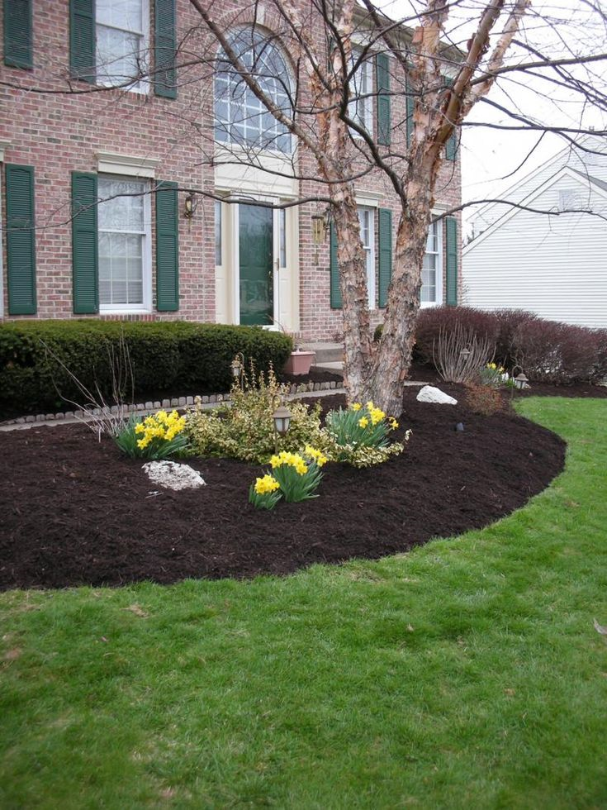
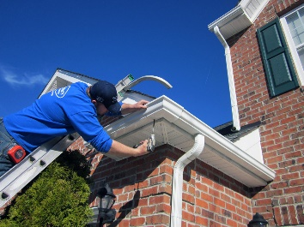
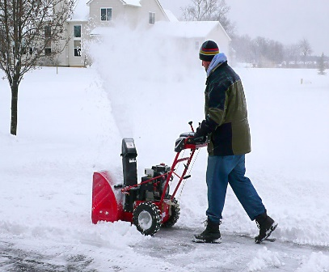
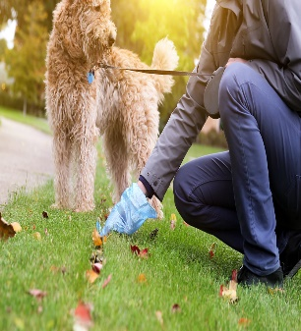
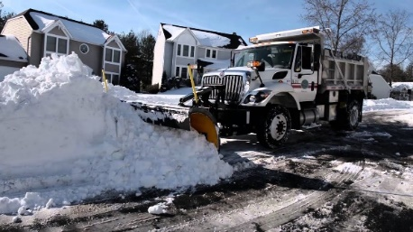
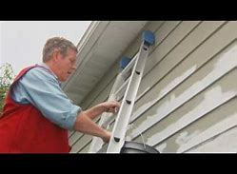
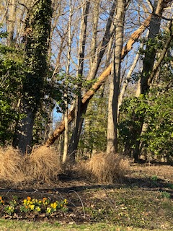
The Docket November 2022 2 of 9
Architectural News
Let it Snow
The Community asks that neighbors are considerate of their neighbors and pull cars off the roadways and cul-de-sacs during snow events so plows and salt trucks can get through the neighborhood. Clear roads mean we can travel in and out of our community freely. We also want a clear roads in case emergency vehicles need to get through.
The GALH has hired a contractor to remove snow and ice on our community sidewalks at 3” and above. For neighbors who have sidewalks in front of their houses, you are responsible for removing the snow within 48 hrs. (This is a Howard County Law).
Dogs and Cats
Dogs should be on a leash when on public property. Dogs and cats should not be allowed to roam the neighborhood freely. Pets could be hit by cars if left unattended. Please pick up after your pets and throw the bags in your garbage can out of sight or use the provided dog waste can on summer Home.
2022 Community Projects
Each year the Architectural committee tries to get together group discounts for community projects. This year we have the following projects in mind:
Tree and shrub trimming January 2022
Power Washing Spring 2022
The ArchComm will be sending out notices via our Group Facebook site and email when these projects will be available.
Let it Snow
The Community asks that neighbors are considerate of their neighbors and pull cars off the roadways and cul-de-sacs during snow events so plows and salt trucks can get through the neighborhood. Clear roads mean we can travel in and out of our community freely. We also want a clear roads in case emergency vehicles need to get through.
The GALH has hired a contractor to remove snow and ice on our community sidewalks at 3” and above. For neighbors who have sidewalks in front of their houses, you are responsible for removing the snow within 48 hrs. (This is a Howard County Law).
Dogs and Cats
Dogs should be on a leash when on public property. Dogs and cats should not be allowed to roam the neighborhood freely. Pets could be hit by cars if left unattended. Please see page 4 for dog poop issues.
2020 Community Projects
Each year the Architectural committee tries to get together group discounts for community projects. This year we have the following projects in mind:
Tree and shrub trimming- Power wash project was a success. Many homeowners took advantage of the discount group price and had their houses and driveways cleaned.
Power Washing
Concrete driveway repairs or replacement
The ArchComm will be sending out notices via our Group Facebook site and email when these projects will be available.
Architectural News
Many thanks to our Arch committee Chair, Barb Otten and team
Kristy Mumma, Kathy McCrory, Bonny Smajda and Brenda Schweiger for their help in keeping our community looking beautiful!!!
We are excited to announce three new members:
welcome Jay Cook (Chair), Erik Gregg and Mark Shiplet
Annual Inspections
We will be sending out the inspection notices to the community by the end of February 2016. All members that were in violation will receive an email from the Architectural Committee citing what was noticed. If you are notified, the Architectural committee will expect your attention to the items we found. If you have any questions you can email the Architectural committee at: ArchComm@TheGablesInfo.com
Arch Alteration Application Form
If you are going to do any improvements to the exterior of your home, you are required to complete the Arch Alteration form that is located on our website at thegablesinfo.com under the tab “forms” and return it to the Architectural Committee for review. A full description is needed and, requires two (2) adjoining neighbors' signatures.
This requirement maintains our community standards and values. Thank you to all the homeowners who have followed the procedure in the past. Should you have any questions, please send an email to the Arch committee at ArchComm@thegablesinfo.com
Tree Trimming Project
Our community tree trimming project is under way. Thanks to the neighbors who signed up.
Weather permitting we hope to have this project completed by mid February.
.
For your convenience below is a link to our Architectural exterior change form
http://www.gablesatlawyershill.com/wp-content/uploads/2011/09/Arch-Alteration-Application-Form-current3.pdf
Please email completed form to:
archcomm@thegablesinfo.com
For your convenience below is a link to our Architectural exterior change form
http://www.gablesatlawyershill.com/wp-content/uploads/2011/09/Arch-Alteration-Application-Form-current3.pdf
Please email completed form to:
archcomm@thegablesinfo.com
After Photos will be inserted after Tuesday’s project

Slide 3
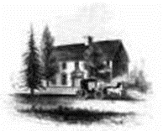

The Docket November 2022 3 of 9
Architectural News
Let it Snow
The Community asks that neighbors are considerate of their neighbors and pull cars off the roadways and cul-de-sacs during snow events so plows and salt trucks can get through the neighborhood. Clear roads mean we can travel in and out of our community freely. We also want a clear roads in case emergency vehicles need to get through.
The GALH has hired a contractor to remove snow and ice on our community sidewalks at 3” and above. For neighbors who have sidewalks in front of their houses, you are responsible for removing the snow within 48 hrs. (This is a Howard County Law).
Dogs and Cats
Dogs should be on a leash when on public property. Dogs and cats should not be allowed to roam the neighborhood freely. Pets could be hit by cars if left unattended. Please see page 4 for dog poop issues.
2020 Community Projects
Each year the Architectural committee tries to get together group discounts for community projects. This year we have the following projects in mind:
Tree and shrub trimming- Power wash project was a success. Many homeowners took advantage of the discount group price and had their houses and driveways cleaned.
Power Washing
Concrete driveway repairs or replacement
The ArchComm will be sending out notices via our Group Facebook site and email when these projects will be available.
Architectural News
Many thanks to our Arch committee Chair, Barb Otten and team
Kristy Mumma, Kathy McCrory, Bonny Smajda and Brenda Schweiger for their help in keeping our community looking beautiful!!!
We are excited to announce three new members:
welcome Jay Cook (Chair), Erik Gregg and Mark Shiplet
Annual Inspections
We will be sending out the inspection notices to the community by the end of February 2016. All members that were in violation will receive an email from the Architectural Committee citing what was noticed. If you are notified, the Architectural committee will expect your attention to the items we found. If you have any questions you can email the Architectural committee at: ArchComm@TheGablesInfo.com
Arch Alteration Application Form
If you are going to do any improvements to the exterior of your home, you are required to complete the Arch Alteration form that is located on our website at thegablesinfo.com under the tab “forms” and return it to the Architectural Committee for review. A full description is needed and, requires two (2) adjoining neighbors' signatures.
This requirement maintains our community standards and values. Thank you to all the homeowners who have followed the procedure in the past. Should you have any questions, please send an email to the Arch committee at ArchComm@thegablesinfo.com
Tree Trimming Project
Our community tree trimming project is under way. Thanks to the neighbors who signed up.
Weather permitting we hope to have this project completed by mid February.
.
After Photos will be inserted after Tuesday’s project

Slide 4

The Docket November 2022 4 of 9
2022 Budget Preliminary
Let it Snow
The Community asks that neighbors are considerate of their neighbors and pull cars off the roadways and cul-de-sacs during snow events so plows and salt trucks can get through the neighborhood. Clear roads mean we can travel in and out of our community freely. We also want a clear roads in case emergency vehicles need to get through.
The GALH has hired a contractor to remove snow and ice on our community sidewalks at 3” and above. For neighbors who have sidewalks in front of their houses, you are responsible for removing the snow within 48 hrs. (This is a Howard County Law).
Dogs and Cats
Dogs should be on a leash when on public property. Dogs and cats should not be allowed to roam the neighborhood freely. Pets could be hit by cars if left unattended. Please see page 4 for dog poop issues.
2020 Community Projects
Each year the Architectural committee tries to get together group discounts for community projects. This year we have the following projects in mind:
Tree and shrub trimming- Power wash project was a success. Many homeowners took advantage of the discount group price and had their houses and driveways cleaned.
Power Washing
Concrete driveway repairs or replacement
The ArchComm will be sending out notices via our Group Facebook site and email when these projects will be available.
Architectural News
Many thanks to our Arch committee Chair, Barb Otten and team
Kristy Mumma, Kathy McCrory, Bonny Smajda and Brenda Schweiger for their help in keeping our community looking beautiful!!!
We are excited to announce three new members:
welcome Jay Cook (Chair), Erik Gregg and Mark Shiplet
Annual Inspections
We will be sending out the inspection notices to the community by the end of February 2016. All members that were in violation will receive an email from the Architectural Committee citing what was noticed. If you are notified, the Architectural committee will expect your attention to the items we found. If you have any questions you can email the Architectural committee at: ArchComm@TheGablesInfo.com
Arch Alteration Application Form
If you are going to do any improvements to the exterior of your home, you are required to complete the Arch Alteration form that is located on our website at thegablesinfo.com under the tab “forms” and return it to the Architectural Committee for review. A full description is needed and, requires two (2) adjoining neighbors' signatures.
This requirement maintains our community standards and values. Thank you to all the homeowners who have followed the procedure in the past. Should you have any questions, please send an email to the Arch committee at ArchComm@thegablesinfo.com
Tree Trimming Project
Our community tree trimming project is under way. Thanks to the neighbors who signed up.
Weather permitting we hope to have this project completed by mid February.
.
After Photos will be inserted after Tuesday’s project

Slide 5

The Docket November 2022 5 of 9
2022 Annual Assessment
Let it Snow
The Community asks that neighbors are considerate of their neighbors and pull cars off the roadways and cul-de-sacs during snow events so plows and salt trucks can get through the neighborhood. Clear roads mean we can travel in and out of our community freely. We also want a clear roads in case emergency vehicles need to get through.
The GALH has hired a contractor to remove snow and ice on our community sidewalks at 3” and above. For neighbors who have sidewalks in front of their houses, you are responsible for removing the snow within 48 hrs. (This is a Howard County Law).
Dogs and Cats
Dogs should be on a leash when on public property. Dogs and cats should not be allowed to roam the neighborhood freely. Pets could be hit by cars if left unattended. Please see page 4 for dog poop issues.
2020 Community Projects
Each year the Architectural committee tries to get together group discounts for community projects. This year we have the following projects in mind:
Tree and shrub trimming- Power wash project was a success. Many homeowners took advantage of the discount group price and had their houses and driveways cleaned.
Power Washing
Concrete driveway repairs or replacement
The ArchComm will be sending out notices via our Group Facebook site and email when these projects will be available.
Architectural News
Many thanks to our Arch committee Chair, Barb Otten and team
Kristy Mumma, Kathy McCrory, Bonny Smajda and Brenda Schweiger for their help in keeping our community looking beautiful!!!
We are excited to announce three new members:
welcome Jay Cook (Chair), Erik Gregg and Mark Shiplet
Annual Inspections
We will be sending out the inspection notices to the community by the end of February 2016. All members that were in violation will receive an email from the Architectural Committee citing what was noticed. If you are notified, the Architectural committee will expect your attention to the items we found. If you have any questions you can email the Architectural committee at: ArchComm@TheGablesInfo.com
Arch Alteration Application Form
If you are going to do any improvements to the exterior of your home, you are required to complete the Arch Alteration form that is located on our website at thegablesinfo.com under the tab “forms” and return it to the Architectural Committee for review. A full description is needed and, requires two (2) adjoining neighbors' signatures.
This requirement maintains our community standards and values. Thank you to all the homeowners who have followed the procedure in the past. Should you have any questions, please send an email to the Arch committee at ArchComm@thegablesinfo.com
Tree Trimming Project
Our community tree trimming project is under way. Thanks to the neighbors who signed up.
Weather permitting we hope to have this project completed by mid February.
.
After Photos will be inserted after Tuesday’s project

Slide 6
The Docket November 2020 6 of 9
Let it Snow
The Community asks that neighbors are considerate of their neighbors and pull cars off the roadways and cul-de-sacs during snow events so plows and salt trucks can get through the neighborhood. Clear roads mean we can travel in and out of our community freely. We also want a clear roads in case emergency vehicles need to get through.
The GALH has hired a contractor to remove snow and ice on our community sidewalks at 3” and above. For neighbors who have sidewalks in front of their houses, you are responsible for removing the snow within 48 hrs. (This is a Howard County Law).
Dogs and Cats
Dogs should be on a leash when on public property. Dogs and cats should not be allowed to roam the neighborhood freely. Pets could be hit by cars if left unattended. Please see page 4 for dog poop issues.
2020 Community Projects
Each year the Architectural committee tries to get together group discounts for community projects. This year we have the following projects in mind:
Tree and shrub trimming- Power wash project was a success. Many homeowners took advantage of the discount group price and had their houses and driveways cleaned.
Power Washing
Concrete driveway repairs or replacement
The ArchComm will be sending out notices via our Group Facebook site and email when these projects will be available.
Architectural News
Many thanks to our Arch committee Chair, Barb Otten and team
Kristy Mumma, Kathy McCrory, Bonny Smajda and Brenda Schweiger for their help in keeping our community looking beautiful!!!
We are excited to announce three new members:
welcome Jay Cook (Chair), Erik Gregg and Mark Shiplet
Annual Inspections
We will be sending out the inspection notices to the community by the end of February 2016. All members that were in violation will receive an email from the Architectural Committee citing what was noticed. If you are notified, the Architectural committee will expect your attention to the items we found. If you have any questions you can email the Architectural committee at: ArchComm@TheGablesInfo.com
Arch Alteration Application Form
If you are going to do any improvements to the exterior of your home, you are required to complete the Arch Alteration form that is located on our website at thegablesinfo.com under the tab “forms” and return it to the Architectural Committee for review. A full description is needed and, requires two (2) adjoining neighbors' signatures.
This requirement maintains our community standards and values. Thank you to all the homeowners who have followed the procedure in the past. Should you have any questions, please send an email to the Arch committee at ArchComm@thegablesinfo.com
Tree Trimming Project
Our community tree trimming project is under way. Thanks to the neighbors who signed up.
Weather permitting we hope to have this project completed by mid February.
.
After Photos will be inserted after Tuesday’s project

Slide 7
The Docket November 2020 7 of 9
The Gables at Lawyers Hill Association Wants You!
Continued from page 6
Let it Snow
The Community asks that neighbors are considerate of their neighbors and pull cars off the roadways and cul-de-sacs during snow events so plows and salt trucks can get through the neighborhood. Clear roads mean we can travel in and out of our community freely. We also want a clear roads in case emergency vehicles need to get through.
The GALH has hired a contractor to remove snow and ice on our community sidewalks at 3” and above. For neighbors who have sidewalks in front of their houses, you are responsible for removing the snow within 48 hrs. (This is a Howard County Law).
Dogs and Cats
Dogs should be on a leash when on public property. Dogs and cats should not be allowed to roam the neighborhood freely. Pets could be hit by cars if left unattended. Please see page 4 for dog poop issues.
2020 Community Projects
Each year the Architectural committee tries to get together group discounts for community projects. This year we have the following projects in mind:
Tree and shrub trimming- Power wash project was a success. Many homeowners took advantage of the discount group price and had their houses and driveways cleaned.
Power Washing
Concrete driveway repairs or replacement
The ArchComm will be sending out notices via our Group Facebook site and email when these projects will be available.
Architectural News
Many thanks to our Arch committee Chair, Barb Otten and team
Kristy Mumma, Kathy McCrory, Bonny Smajda and Brenda Schweiger for their help in keeping our community looking beautiful!!!
We are excited to announce three new members:
welcome Jay Cook (Chair), Erik Gregg and Mark Shiplet
Annual Inspections
We will be sending out the inspection notices to the community by the end of February 2016. All members that were in violation will receive an email from the Architectural Committee citing what was noticed. If you are notified, the Architectural committee will expect your attention to the items we found. If you have any questions you can email the Architectural committee at: ArchComm@TheGablesInfo.com
Arch Alteration Application Form
If you are going to do any improvements to the exterior of your home, you are required to complete the Arch Alteration form that is located on our website at thegablesinfo.com under the tab “forms” and return it to the Architectural Committee for review. A full description is needed and, requires two (2) adjoining neighbors' signatures.
This requirement maintains our community standards and values. Thank you to all the homeowners who have followed the procedure in the past. Should you have any questions, please send an email to the Arch committee at ArchComm@thegablesinfo.com
Tree Trimming Project
Our community tree trimming project is under way. Thanks to the neighbors who signed up.
Weather permitting we hope to have this project completed by mid February.
.
After Photos will be inserted after Tuesday’s project

Slide 8
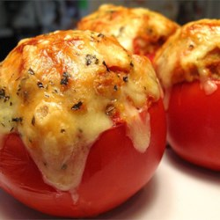
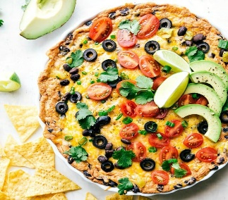
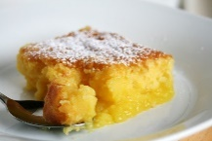
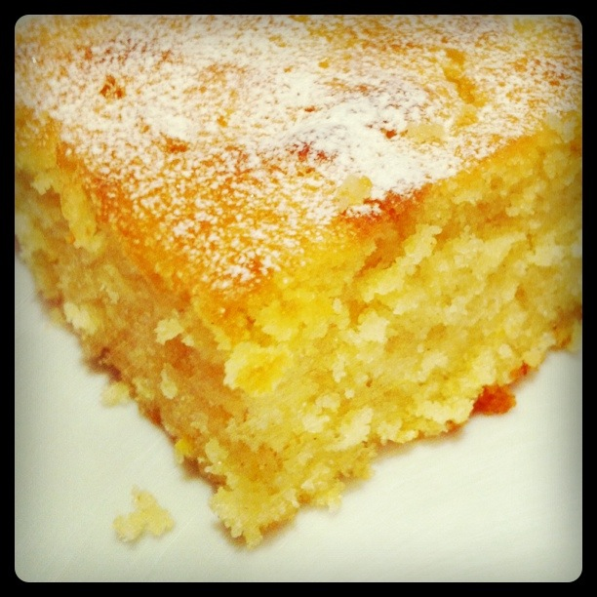
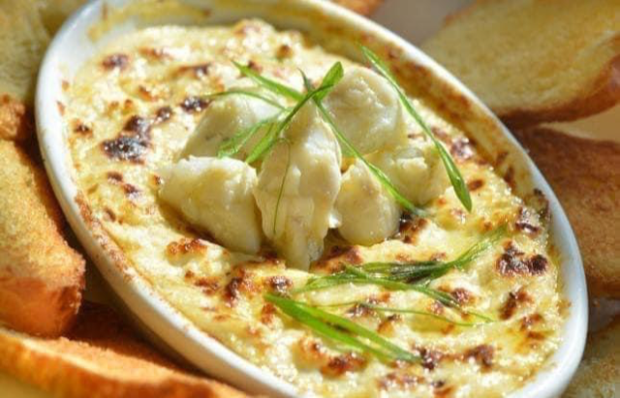
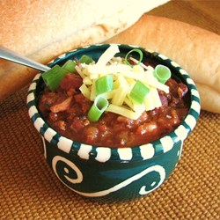
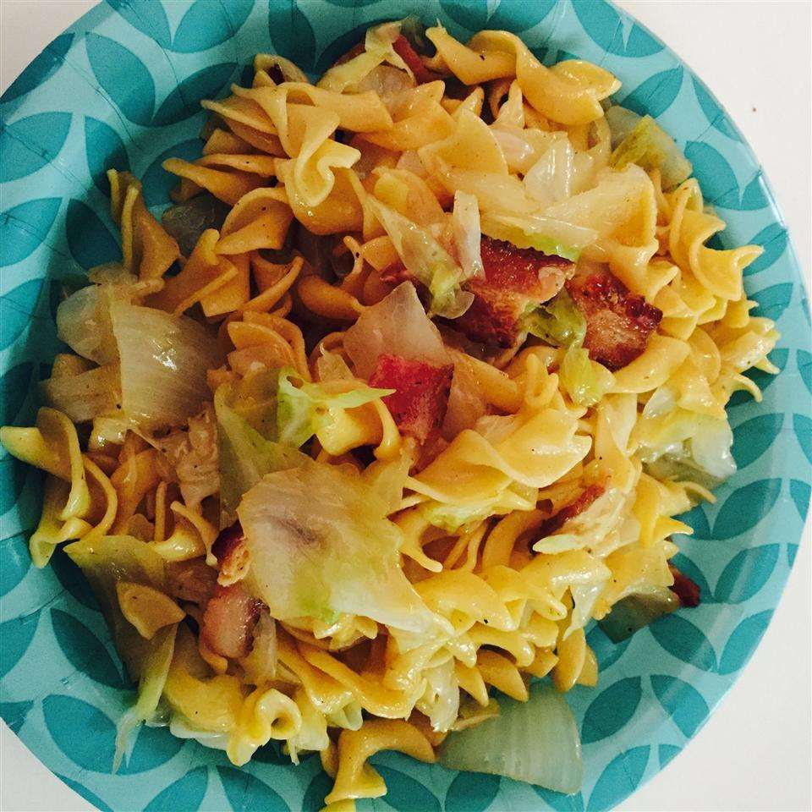
The Docket November 2022 8 of 9
LOUISIANA HOT CRAB 🦀 DIP
Need a healthy appetizer????😋😋😋
Ingredients
- 7oz of crabmeat
- 3 tablespoons of light cream cheese
- 3 and 1/2 tablespoons of regular mayonnaise
- 1/4 cup of reduced-fat parmesan cheese
- 3 tablespoons of green onion
- 2 garlic cloves
- 2 teaspoons of Worcestershire sauce
- 2 teaspoons of lemon juice
- 1 teaspoon of hot sauce
- 1/2 teaspoon of old bay
- 1/4 teaspoon of salt
- 1/2 teaspoon of pepper
Directions
1. Preheat oven to 325 degrees.
2. Combine all ingredients in a casserole dish.
3. Bake for about 35-40 mins in a preheated oven until lightly golden brown on top.
4. Serve hot! Enjoy!!
Makes 7 servings
Important Email & Facebook Addresses
HOA Board- gablesboard@thegablesinfo.com
ArchComm- archcomm@thegablesinfo.com
Webmaster- webmaster@thegablesinfo.com
Facebook Group- The Gables at Lawyers Hill

Slide 9
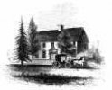

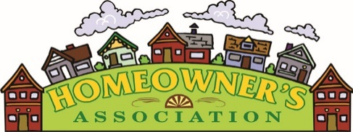



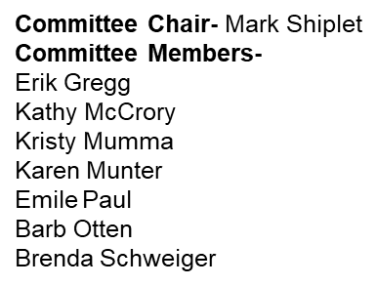



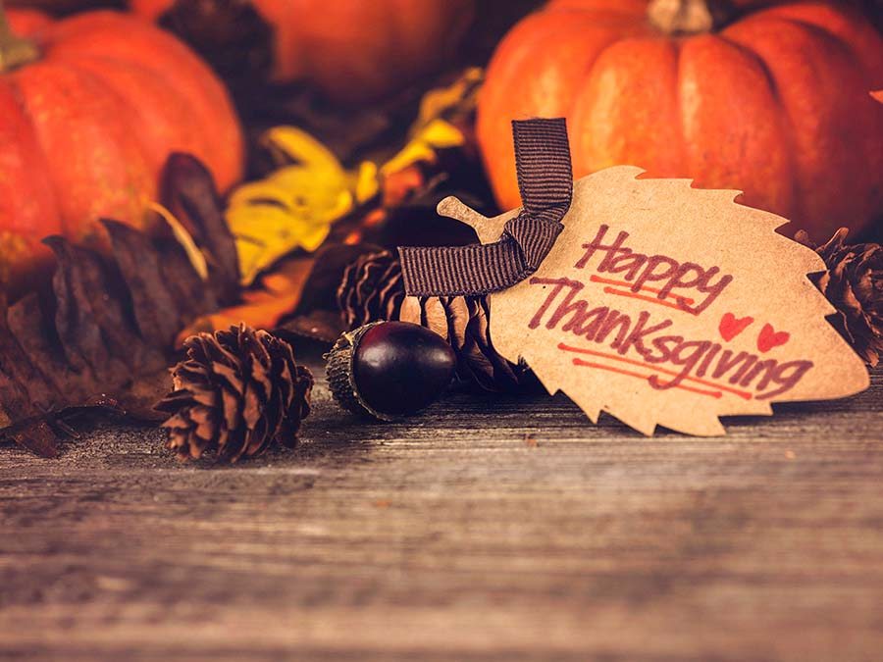



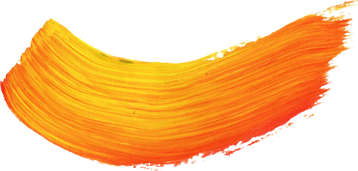

The Docket 2019 November 2020 9 of 9
The Gables at Lawyers Hill Homeowner’s Association
GALH Board
President- Brenda Schweiger
Vice President- Mike Wolek
Treasurer- Bev Johnson
Secretary- Angela Shiplet
Member at Large (1) Ashley Gerrity
Member at Large (2)- Vacant
GALH Website and Editing Committee
Liz Culbertson
Erik Gregg
Brenda Schweiger
Angela Shiplet
Architectural Committee
Committee Chair- Brenda Schweiger (acting)
Karen Munter
Emile Paul
Erik Gregg
Kathy McCrory
Kristy Mumma
Jay Sandusky
Mark Shiplet
Welcome Committee
Susan Lavin
Chris Matney
Fern Nerhood
Angela Shiplet
Laurie Tarsia
Important Emails and Community Closed Facebook Address
GALH Board- gablesboard@thegablesinfo.com
GALH Architectural Committee- archcomm@thegablesinfo.com
GALH Welcome Committee- welcomecomm@gablesatlawyershill.com
GALH Facebook Group- Gables at Lawyers Hill
Little Library- littlelibrary@gablesatlawyershill.com

